Slide 1
FEMALE REPRODUCTIVE SYSTEM
M. G. HAMMAD

Slide 2
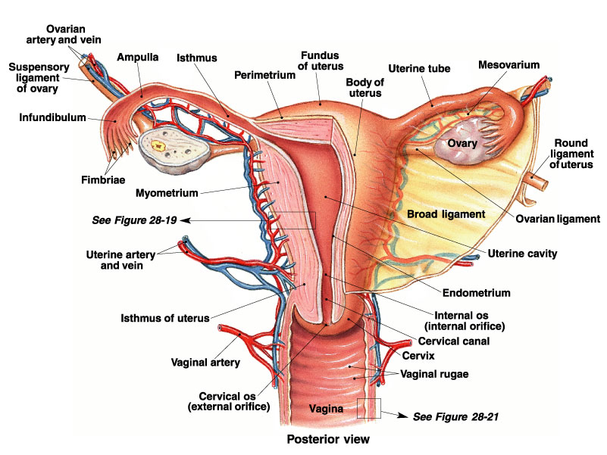
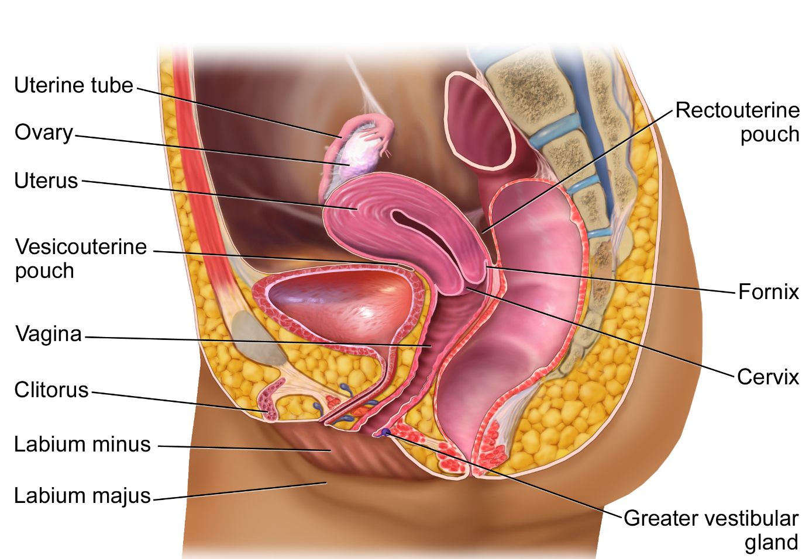
ANATOMICAL ASPECTS:

Slide 3
ANATOMICAL ASPECTS:
It includes:
PRIMARY SEX ORGANS: TWO OVARIES.
ACCESSORY SEX ORGANS: FALLOPIAN TUBES, UTERUS, VAGINA, EXTERNAL GENITALIA.

Slide 4
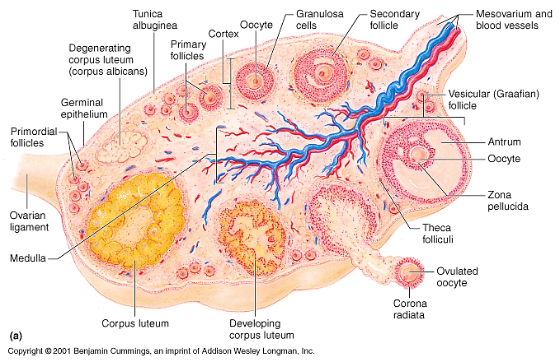
HISTOLOGICAL ASPECTS: OVARY

Slide 5
HISTOLOGICAL ASPECTS: OVARY
Flattened almond-shaped body.
Covered by germinal epithelium.
And CT capsule.
GERMINAL EPI:
SIMPLE CUBOIDAL :in young female.
SIMPLE SQUAMOUS: in old woman.
THE CAPSULE: TUNICA ALBUGINEA.

Slide 6
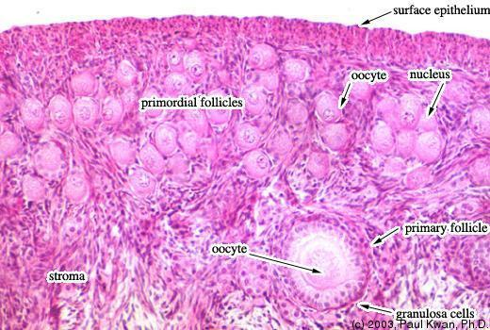
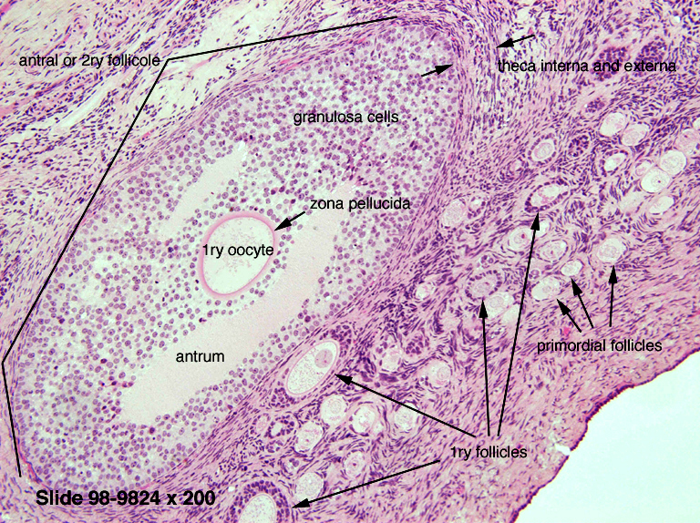
STRUCTURES OF OVARY

Slide 7
STRUCTURES OF OVARY
Ovary formed of:
STROMA: CT.
PARENCHYMA:
OVARIAN FOLLICLES.
INTERFOLLICULAR CELLS.

Slide 8
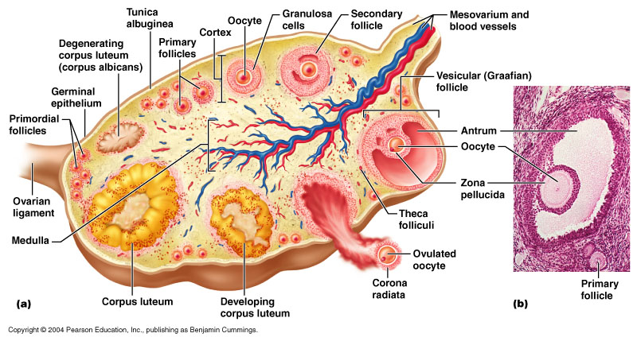
OVARIAN STROMA
Composed of:
CORTEX.
MEDULLA.
CORTEX:
Broader.
Contains:
Ovarian follicles.
CT: fibroblast, stromal cells, collagenous fibers.

Slide 9
OVARIAN STROMA
MEDULLA:
Small.
Composed of loose CT.
CT contains:
Elastic fibers.
Smooth muscles.
Many BLOOD VESSELS.

Slide 10
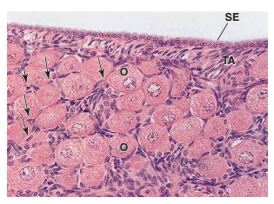
OVARIAN PARENCHYMA
Consists of :
INTERFOLLICULAR CELLS.
OVARIAN FOLLICLES.
INTERFOLLICULAR CELLS:
Called interstitial cells.
Present between ovarian follicles.
Flat cells.
With round nuclei.

Slide 11
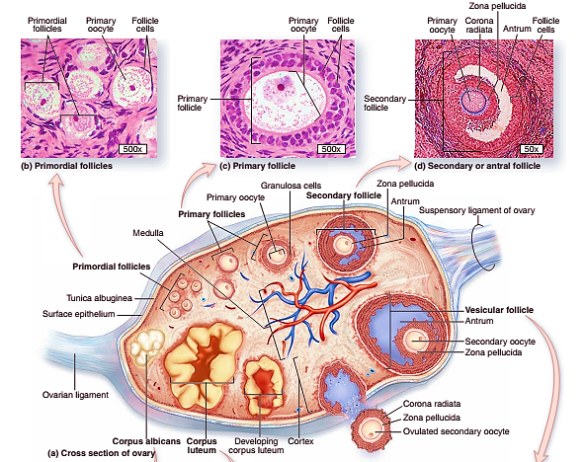
OVARIAN PARENCHYMA
OVARIAN FOLLICLES:
Present in CORTEX.
They include:
PRIMORDIAL FOLLICLES.
PRIMARY FOLLICLES.
SECONDARY{GROWING} FOLLICLES.
GRAAFIAN{MATURE} FOLLICLES.

Slide 12
HISTOLOGICAL ASPECTS: FALLOPIAN TUBE

Slide 13
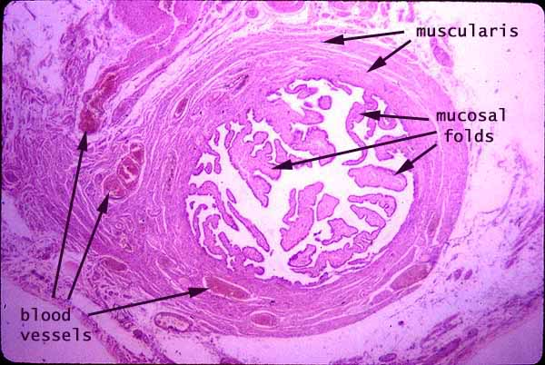
HISTOLOGICAL ASPECTS: FALLOPIAN TUBE
Its wall composed of:
MUCOSA.
MUSCULAR LAYER.
SEROSA.

Slide 14
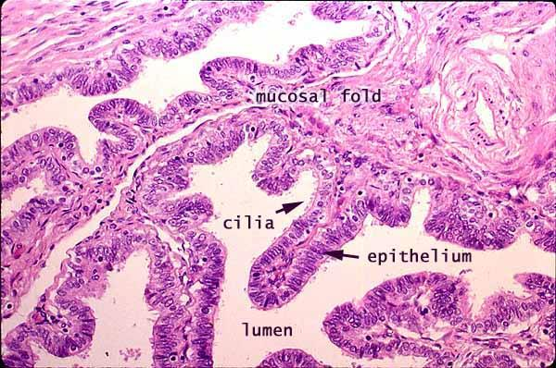
STRUCTURES OF FALLOPIAN TUBE
MUCOSA:
Highly folded.
Lined by SIMPLE COLUMNAR EPI.
EPI has 2 type:
CILIATED COLUMNAR EPI.
NONCILIATED COLUMNAR EPI.
EPI supported by lamina Propria(CORIUM).

Slide 15
UTERUS

Slide 16
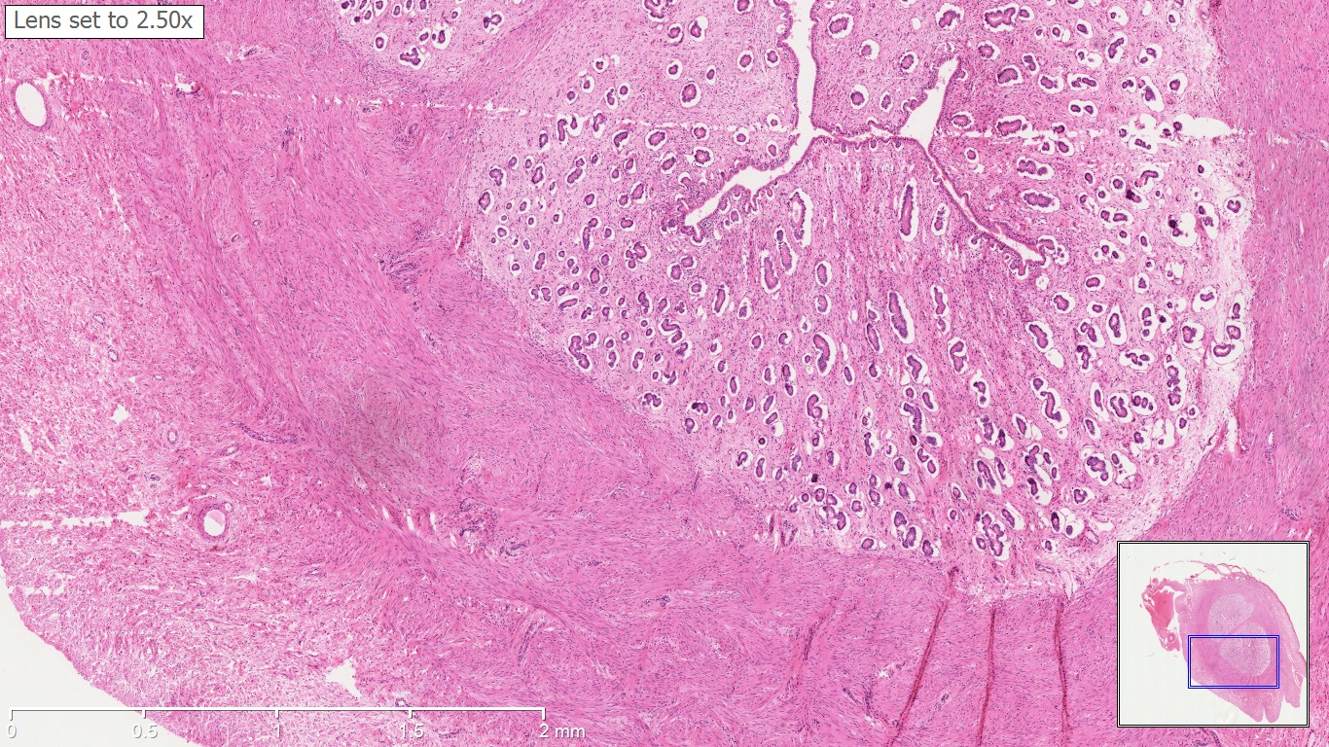
HISTOLOGICAL ASPECTS: UTERUS
Its wall composed of:
Inner layer: ENDOMETRIUM.
Middle layer: MYOMETRIUM.
Outer layer: PERIMETRIUM.

Slide 17
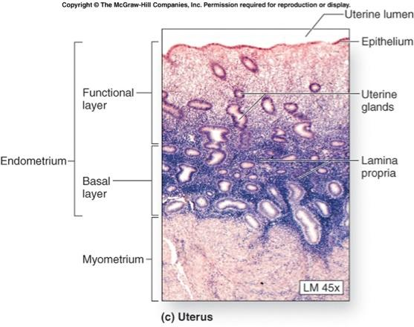
HISTOLOGICAL ASPECTS: UTERUS
ENDOMETRIUM:
Uterine mucosa.
It divided into:
Superficial FUNCTIONAL ZONE.
Deep BASAL ZONE.

Slide 18
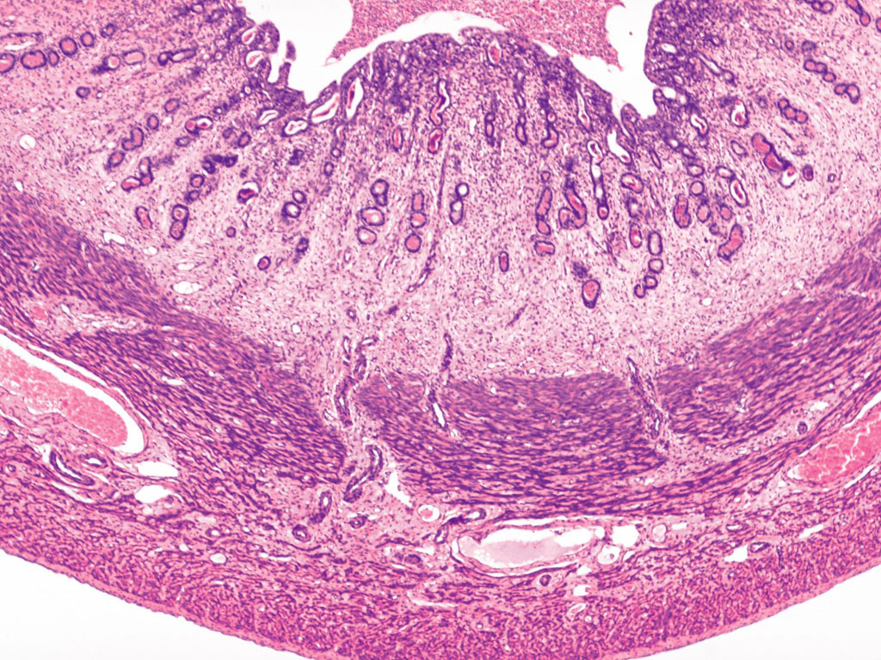
HISTOLOGICAL ASPECTS: UTERUS
ENDOMETRIUM
A
B
C

Slide 19
HISTOLOGICAL ASPECTS: UTERUS
Structures of ENDOMETRIUM:
EPITHELIUM:
Simple columnar EPI {ciliated & non ciliated}.
UTERINE GLANDS:
Tubular or branched glands.
Lind by SIMPLE COLUMNAR EPI.
CORIUM OF CT:
Between uterine glands.
Rich B V.

Slide 20
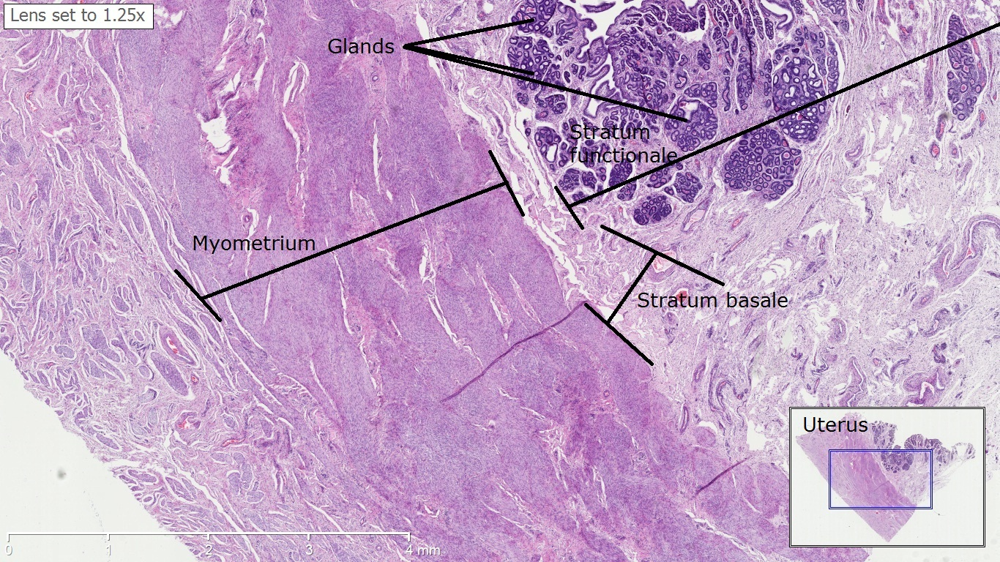
HISTOLOGICAL ASPECTS: UTERUS

Slide 21
HISTOLOGICAL ASPECTS: UTERUS
MYOMETRIUM
A
B
C

Slide 22
HISTOLOGICAL ASPECTS: UTERUS
MYOMETRIUM:
Thick smooth muscle layers.
3 layers:
SUBMUCOSAL LAYER: longitudinal and oblique.
VASCULAR LAYER: contains B V.
SUBSEROSAL LAYER: longitudinal and oblique.

Slide 23
HISTOLOGICAL ASPECTS: UTERUS
PERIMETRIUM

Slide 24
HISTOLOGICAL ASPECTS: UTERUS
PERIMETRIUM:
Formed of areolar CT.
Contains blood vessels.
Covered by SIMPLE SQUAMOUS EPI

Slide 25
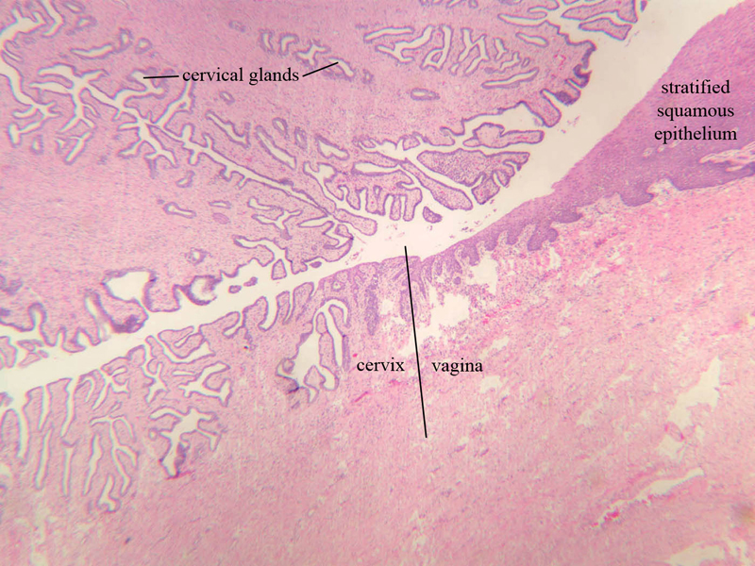
UTERINE CERVIX

Slide 26
UTERINE CERVIX
Its wall formed of.
Dens fibrous CT.
Few smooth muscle fibers.
With BRANCHED TUBULO-ACINAR GLANDS(CERVICAL GLANDS).
Lumen of cervix lined by:
SIMPLE COLUMNAR EPI: at lumen and internal OS.
STRATIFIED SQUAMOUS EPI: at external OS.

Slide 27
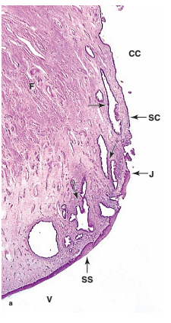
UTERINE CERVIX

Slide 28
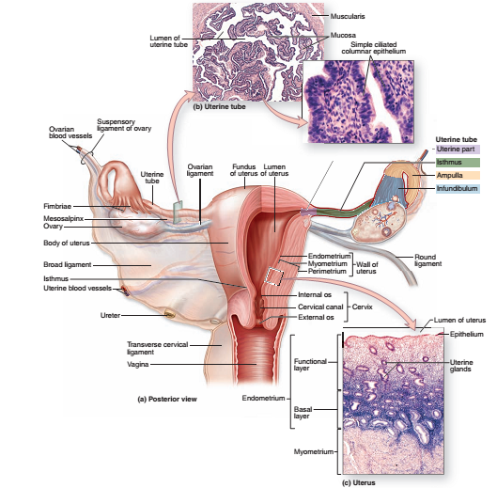
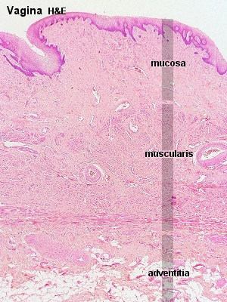
THE VAGINA

Slide 29
THE VAGINA
Fibromuscular tube.
Its wall composed of:
MUCOSA.
MUSCULOSA.
ADVENTITIA.

Slide 30
THE VAGINA

Slide 31
THE VAGINA
MUCOSA:
Lined by STRATIFIED SQUAMOUS NON-KERATINIZING.
Supported by CT (CORIUM), rich in B V.
No vaginal GLANDS here.
MUSCULOSA:
Smooth muscle fibers {INNER CIRCULAR, OUTER LONGITUDINAL}.
ADVENTITIA:
Fibrous CT.
Rich in B V, N.

Slide 32
THAT IS ALL

